Slide 1
Development of touch type Electric Gayageum for an experience-oriented exhibition
Team 9
Kyungpook National University – Computer Science and Engineering
2013105067 Lee Gyu Dong (leader)
2013105030 Gim Han Yeong
2011097084 Han Jae Hyun
Kumoh National Institute of Technolongy – Computer Science
20160437 Ma Jui
20160168 Kim Myeong Ji

Slide 2
Project Background and Purpose
Classical music instrument
Expensive
Difficult
Public Recognition
Change
To get close to the public.
Especially to be familiar with children.
Electronic Korean Instrument

Slide 3
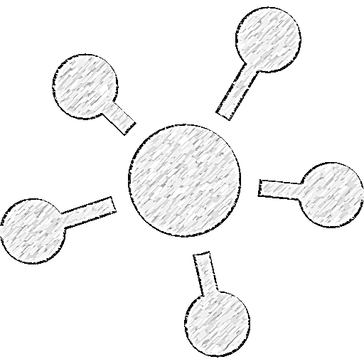
Project differentiation
Data of education
Using Arduino
Touch sensor & Pressure sensor
Real gayageum sound
Automatical LED light score

Slide 4

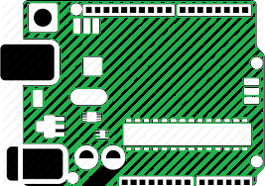

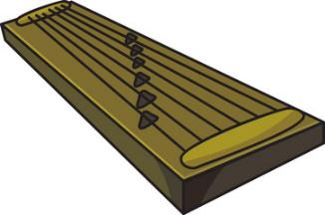
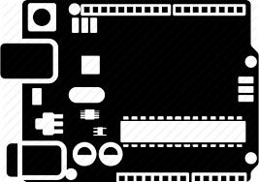

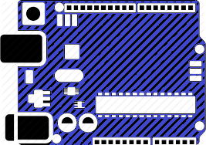
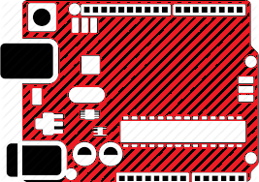
System Block Diagram
output
input
Touch module
Arduino
UNO
Arduino
Pro micro
DF player

Slide 5

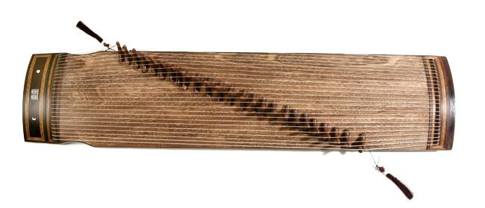
System Block Diagram
MAKE SOUND
TUNE UP

Slide 6
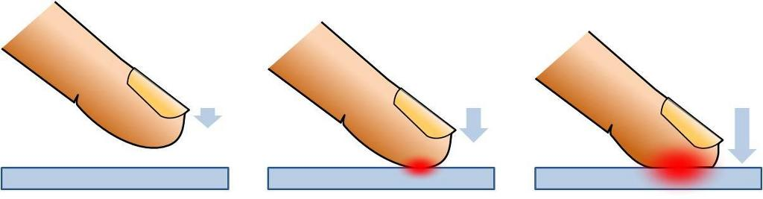

System Block Diagram
Pressure Sensor
TUNE UP

Slide 7
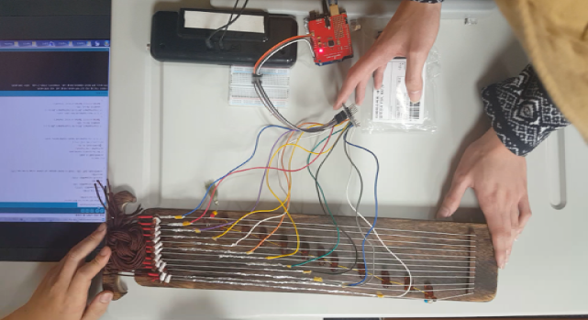
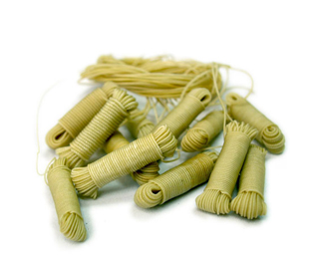
Problems
Need storage space
Need to change with
Electrically conductive object

Slide 8
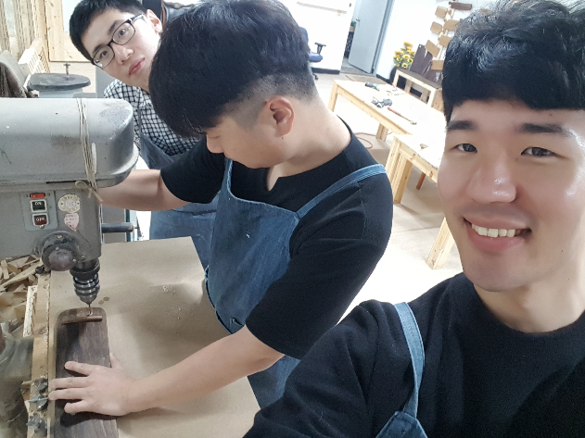
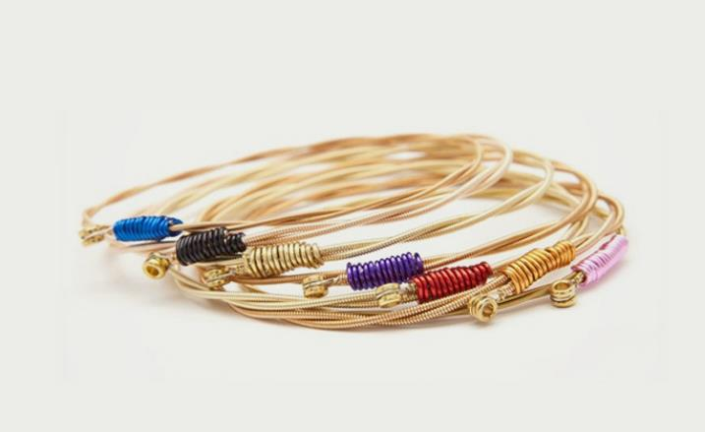
Solution
Make space
Change with guitar string

Slide 9


Point of improvement
Delay Buffer
Without
Multi sound

Slide 10
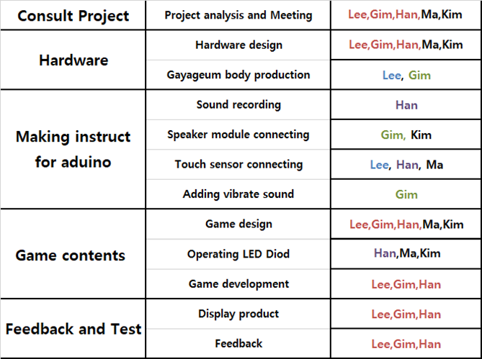
Project Distributing Roles

Slide 11
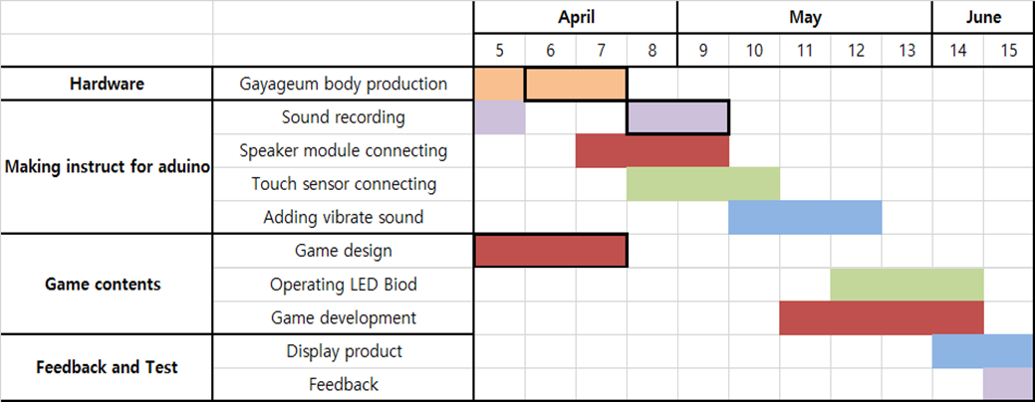
Project Schedule

Slide 12
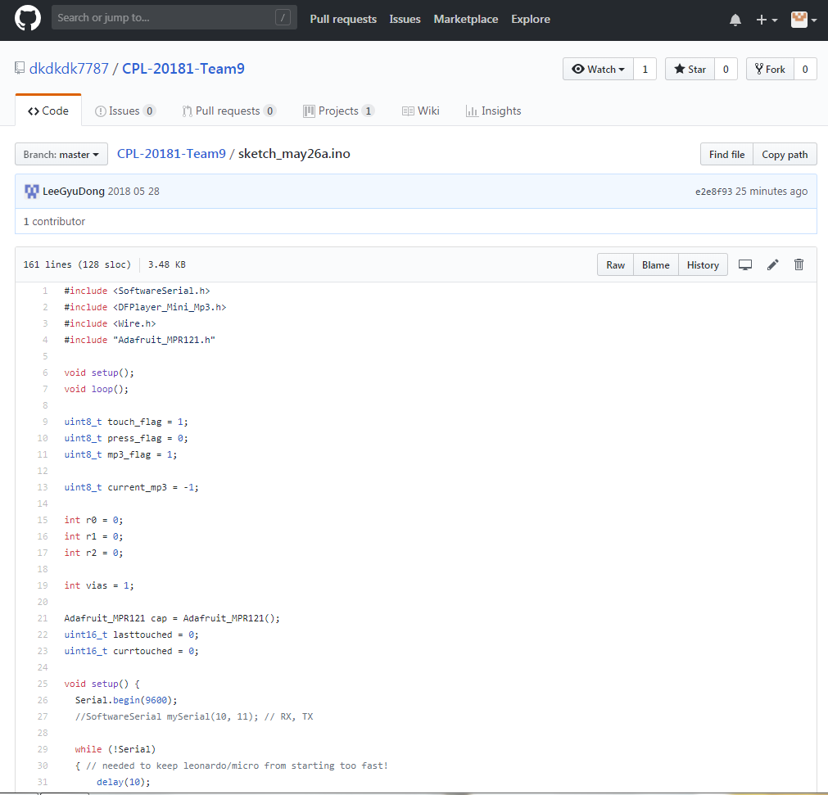
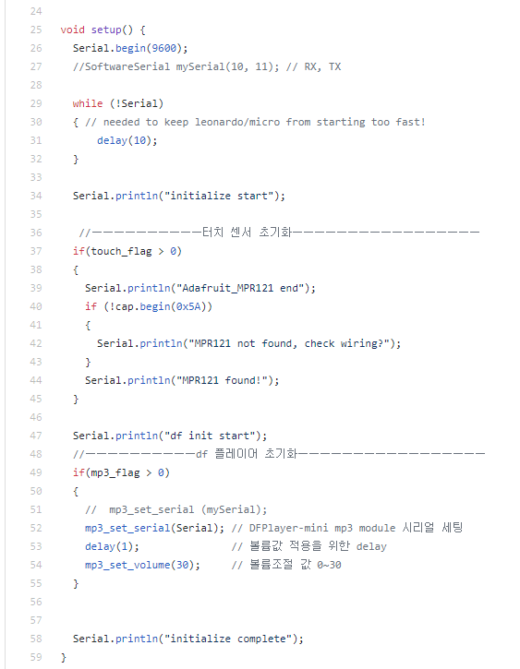
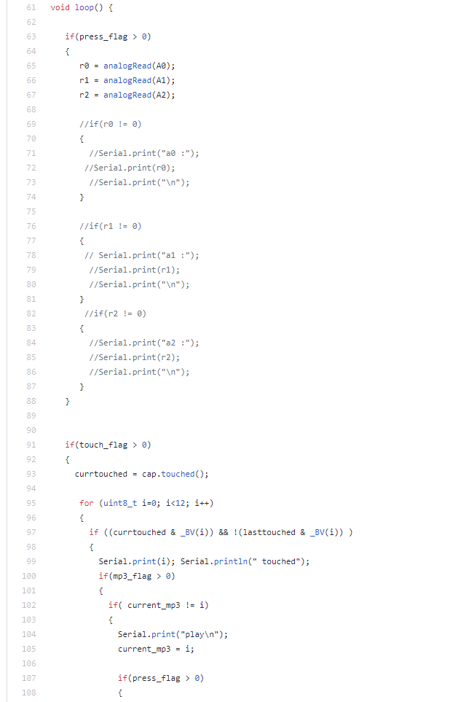

Slide 13
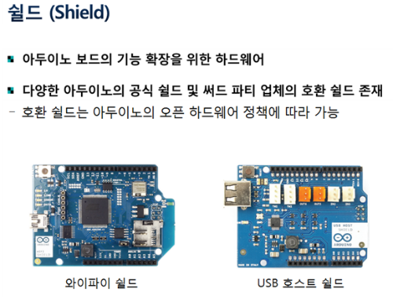
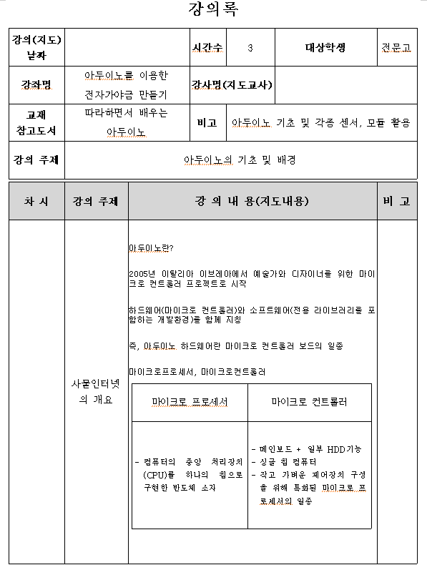
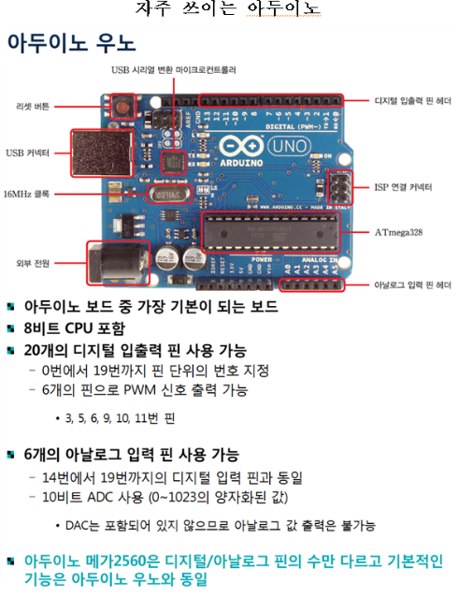
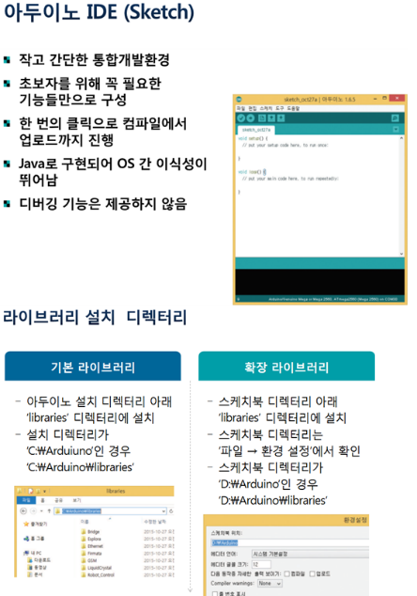
Data of education

Slide 14
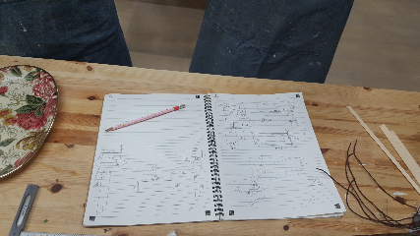
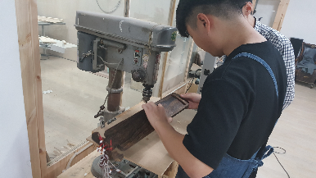
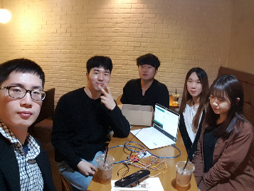

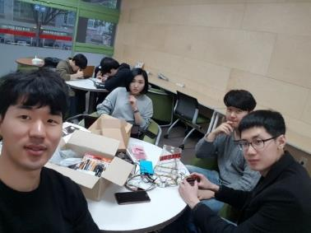
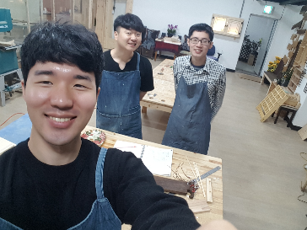
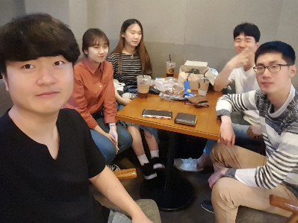
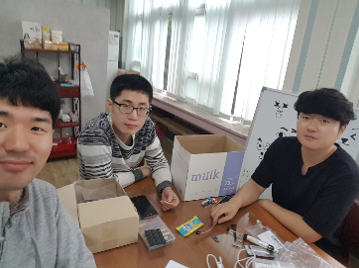
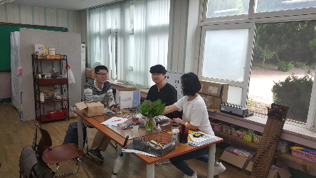
Meeting

Slide 15
Q&A
Thanks.

